Slide 1

Void
Conceptual Architecture
We Can’t Code Well
CISC 322 – A1 Presentation
Mark & Ameek

Slide 2
Void?
Void is an open-source AI code editor
Identify parts, interactions, global flow, concurrency using VS Code’s two-process baseline.

Slide 3


VOID*

Slide 4



VOID*
IDE + AI, no trade-offs
Browser Client
Electron Main

Slide 5
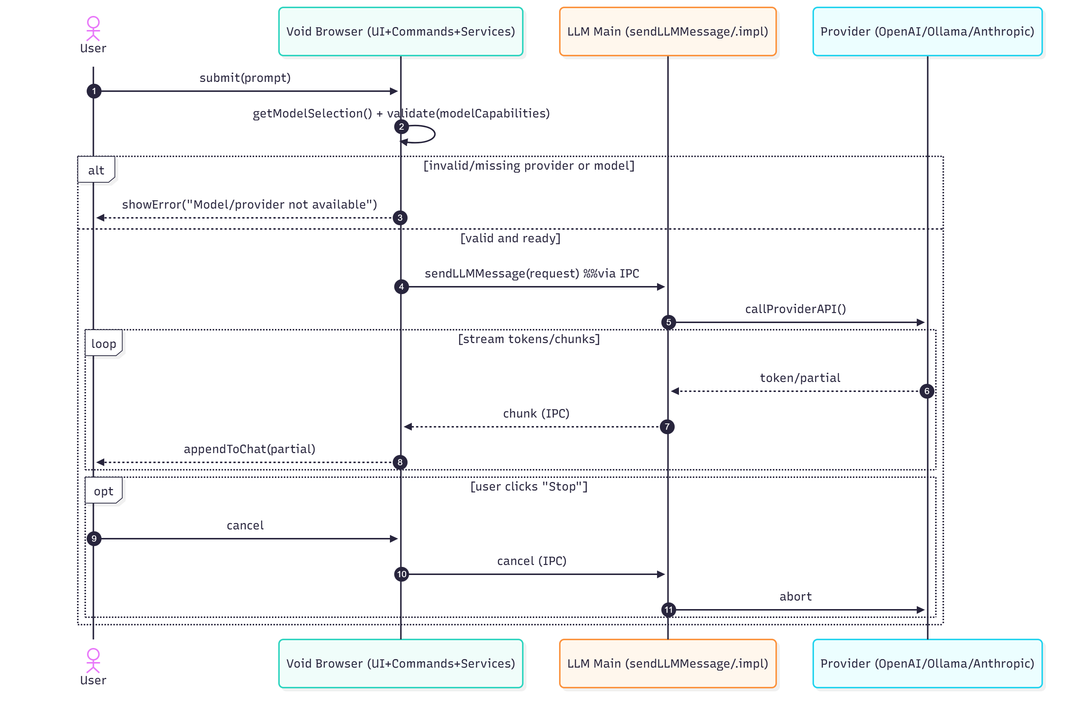

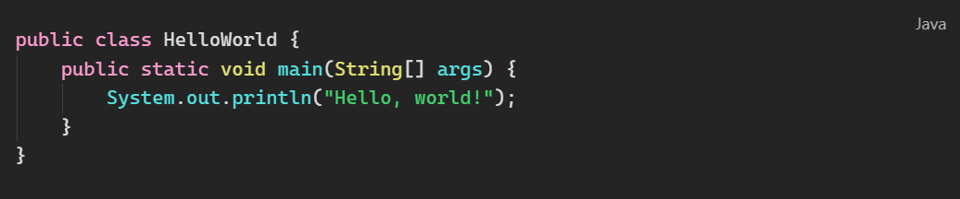
End-
to-
End

Slide 6
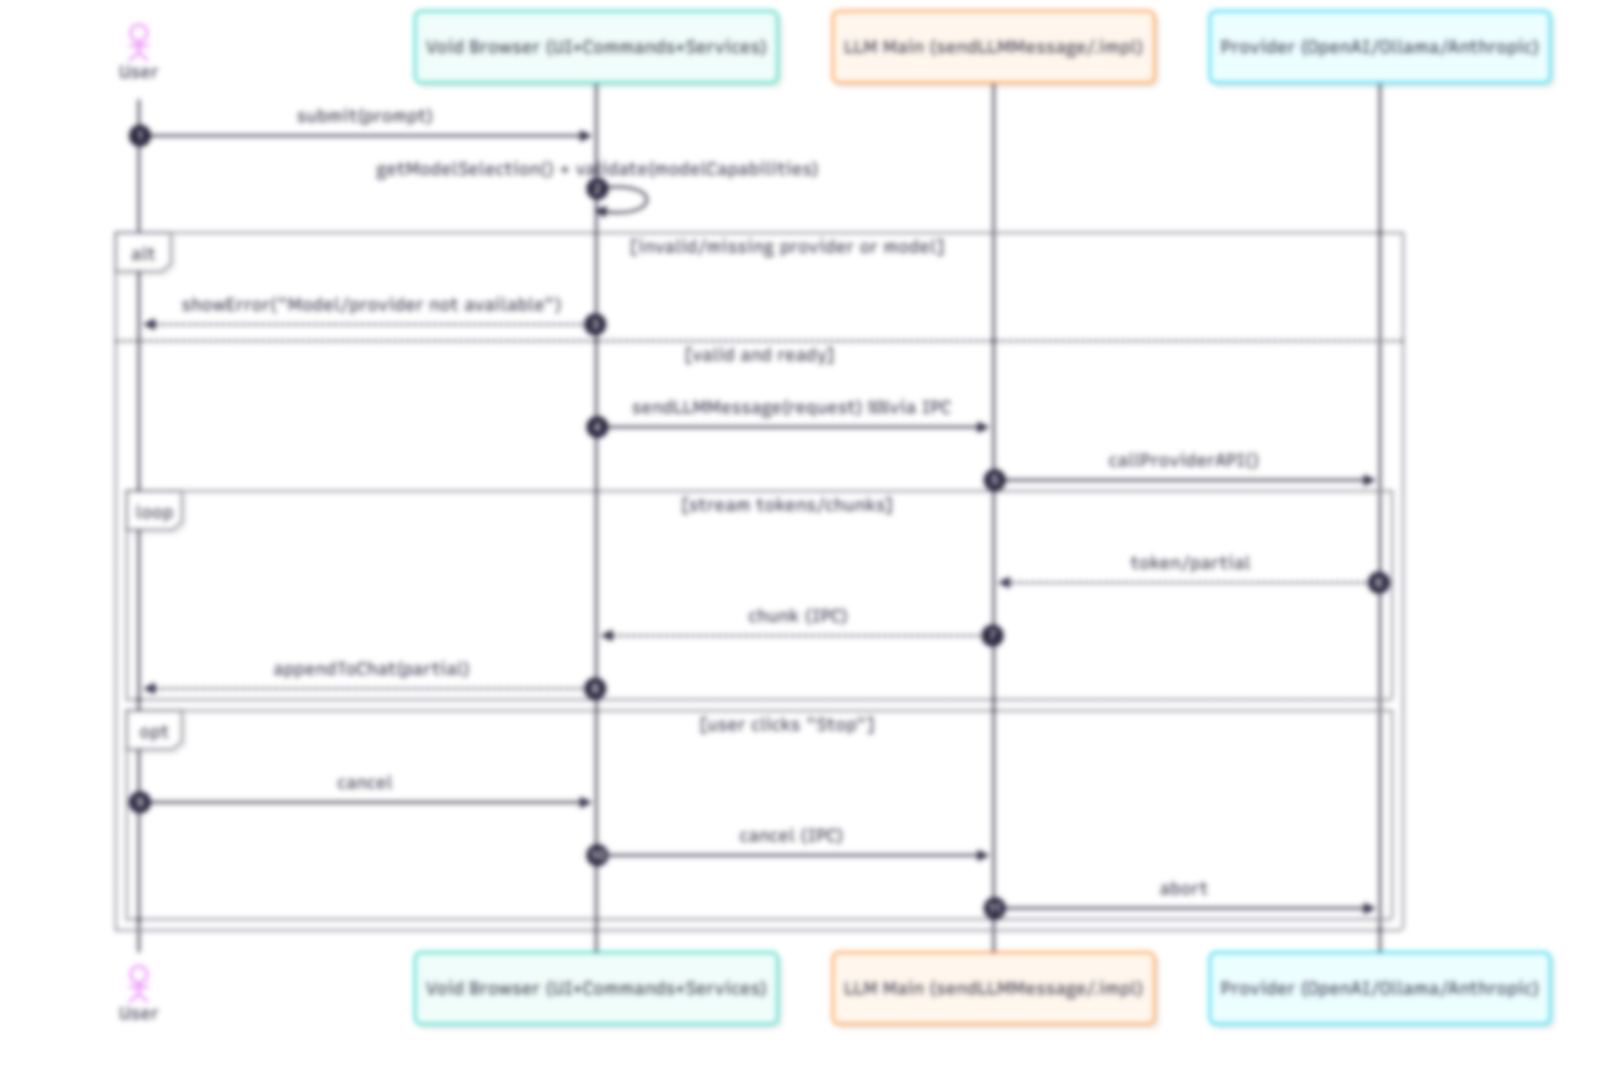

End-
to-
End
Notes:
User submits. “First, the user types a prompt and hits Enter. That lands in the Browser side—think of it as the front desk.”
Browser prepares and guards. “Before we send anything out, the Browser looks up the selected provider and model and checks modelCapabilities to make sure that combo is allowed. If it’s invalid, we immediately show an error to the user and stop there.”
Hand off to Main (IPC). “If it’s valid, the Browser packages the request and sends it to the Main process using our internal channel—IPC. Main is our back office; it can use Node libraries and talk to external services.”
Main calls the provider. “Main receives the request and calls the chosen LLM provider—OpenAI, Ollama, Anthropic—with streaming turned on.”
Stream back to the UI. “As the provider generates text, it comes back in small pieces. Main forwards each piece over IPC to the Browser, and the Browser appends it live in the chat. That’s why you see the answer appear word-by-word.”
Optional cancel. “If the user clicks Stop, the cancel flows back down: Browser tells Main, Main tells the provider to abort, and we keep whatever text has already arrived.”

Slide 7
End-
to-
End
Notes:
User submits. “First, the user types a prompt and hits Enter. That lands in the Browser side—think of it as the front desk.”
Browser prepares and guards. “Before we send anything out, the Browser looks up the selected provider and model and checks modelCapabilities to make sure that combo is allowed. If it’s invalid, we immediately show an error to the user and stop there.”
Hand off to Main (IPC). “If it’s valid, the Browser packages the request and sends it to the Main process using our internal channel—IPC. Main is our back office; it can use Node libraries and talk to external services.”
Main calls the provider. “Main receives the request and calls the chosen LLM provider—OpenAI, Ollama, Anthropic—with streaming turned on.”
Stream back to the UI. “As the provider generates text, it comes back in small pieces. Main forwards each piece over IPC to the Browser, and the Browser appends it live in the chat. That’s why you see the answer appear word-by-word.”
Optional cancel. “If the user clicks Stop, the cancel flows back down: Browser tells Main, Main tells the provider to abort, and we keep whatever text has already arrived.”

Slide 8
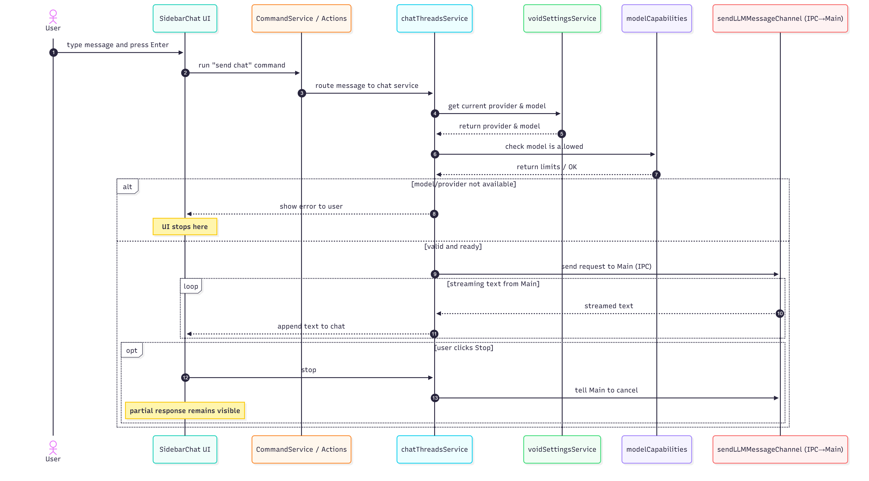
Browser

Slide 9
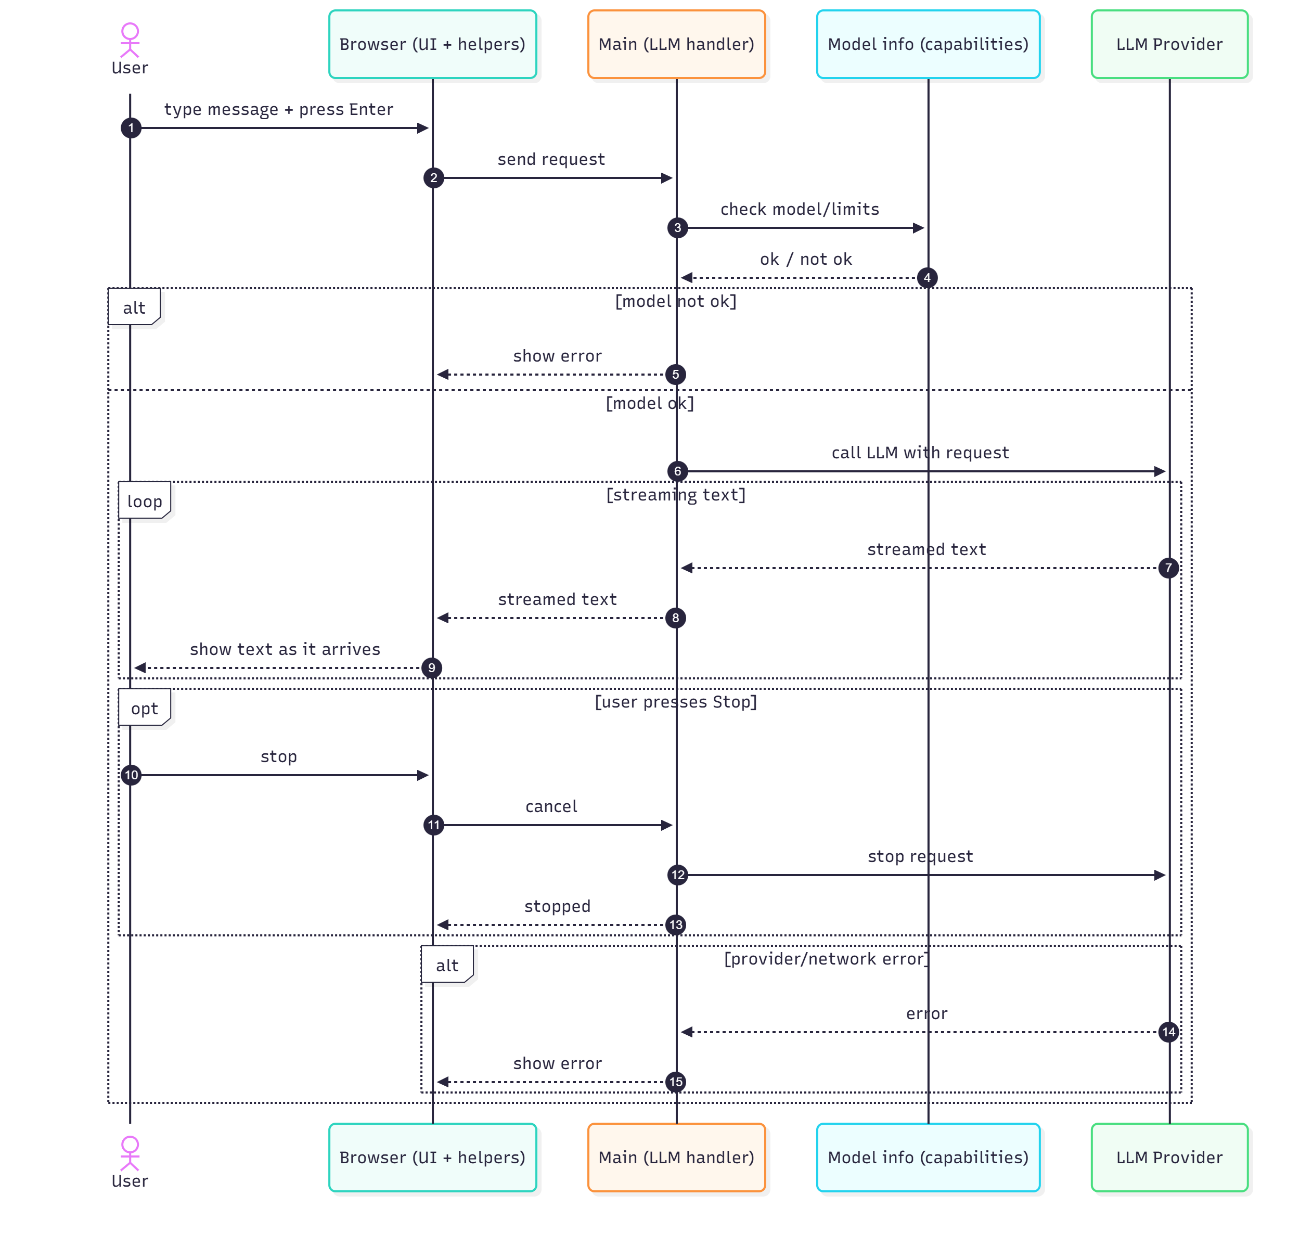
Main

Slide 10
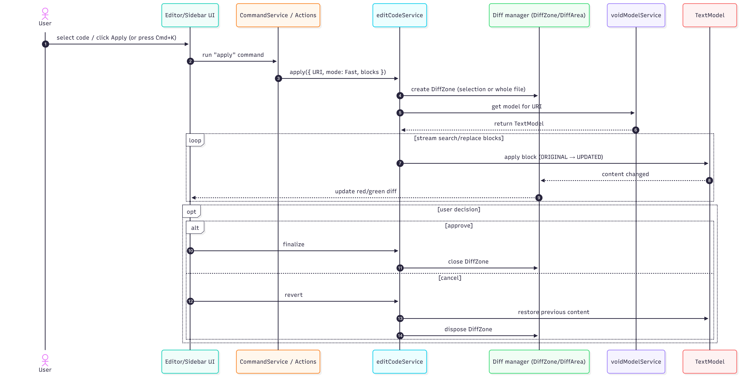
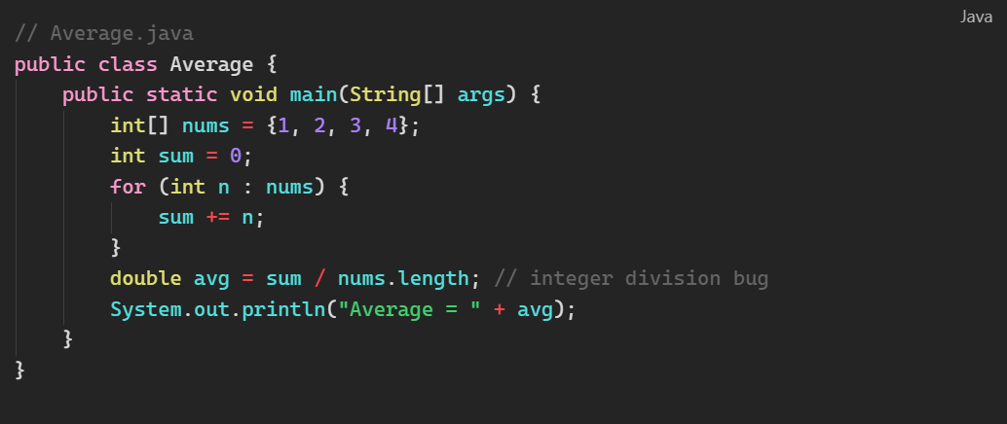
Fast-Apply

Slide 11
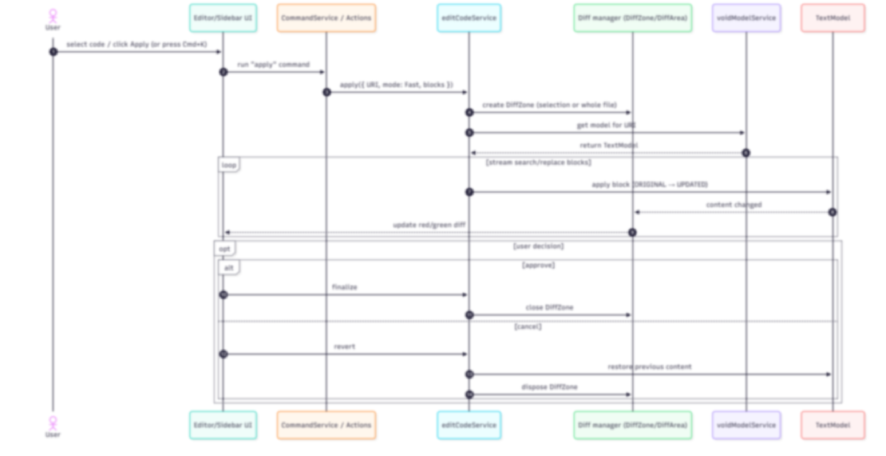
Diff
Fast-Apply

Slide 12
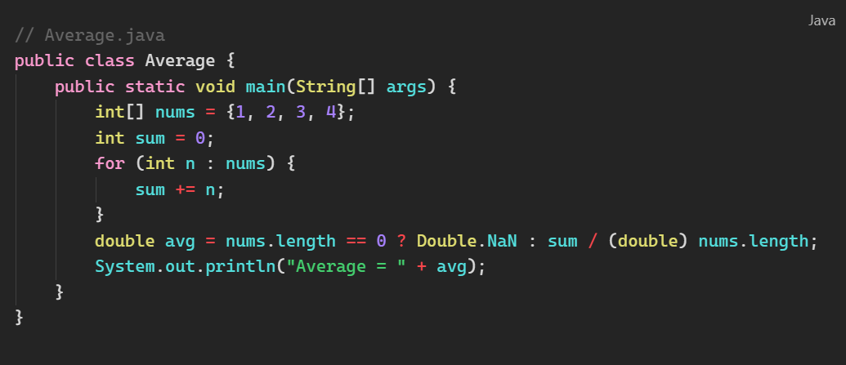
Diff
Fast-Apply

Slide 13
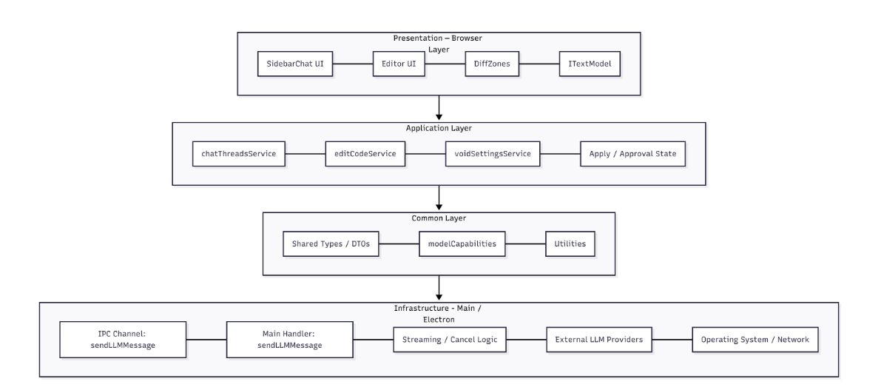

Slide 14
Why not Pipe and Filter?

Slide 15
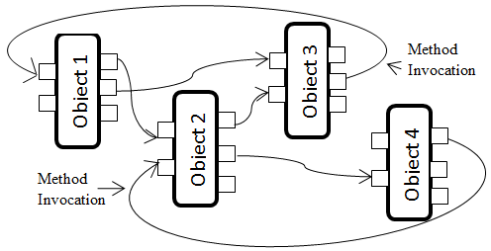
Why not Object Oriented?

Slide 16
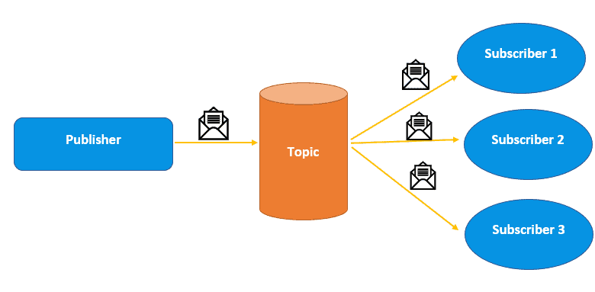
Why not Pub Sub?

Slide 17
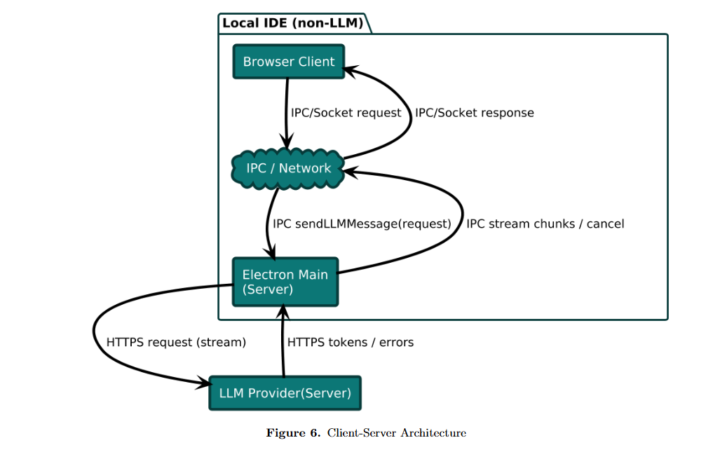

Slide 21
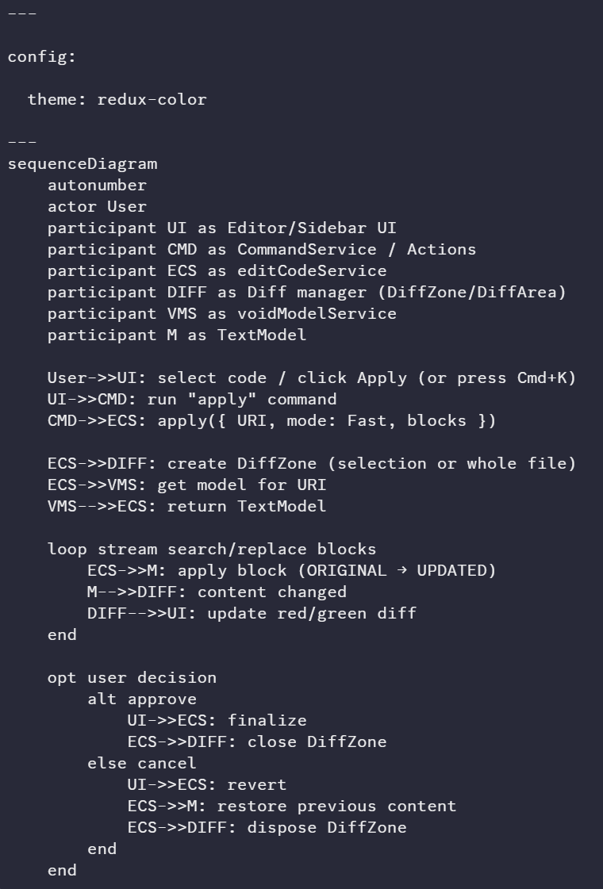
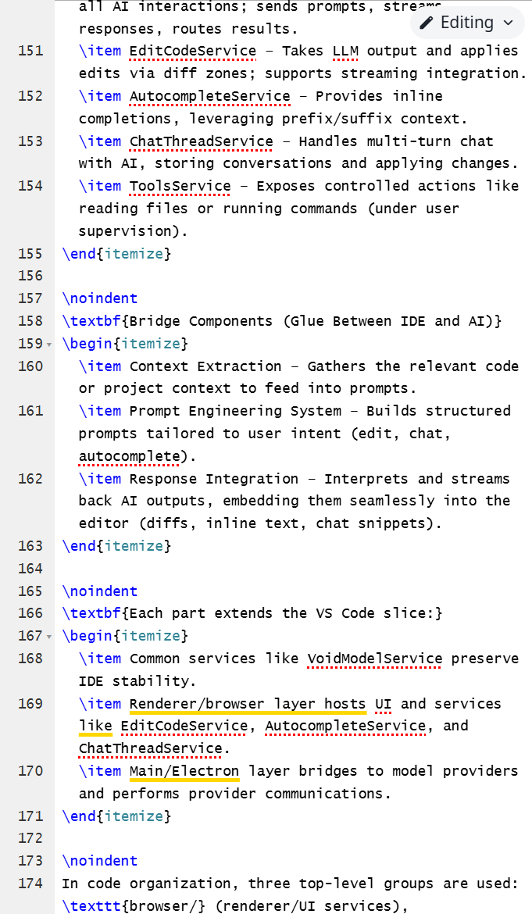


> Have you ever considered adding FUBAR?

Slide 22
